Slide 1
Machine Learning- introduction
ALCON
Warsaw, 29th Nov

Slide 2

Agenda for workshops:
15 Nov.
Introduction to ML, Unsupervised learning
29 Nov.
Supervised Learning
13 Dec.
End - to End machine learning project

Slide 3
Agenda for today:
16.00 - 16.15 | Kahoot!
16.15 - 16.30 | Supervised Machine Learning - basics
16.30 - 16.45 | Model validation
16.45 - 16.55 | Break
17.00 - 17.10 | Model overfitting
17.10 -17.30 | Parameters tunning
17.30 - 17.50 | Case study
17.50 - 18.00 | QA

Slide 4

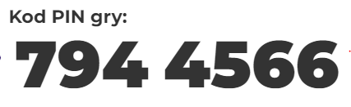

Slide 5

Supervised Machine Learning
Models learn from labeled data (X,y) (X,y) (ground truth)
Given a new input X, predict the right output y
Supervised learning is classified into two categories of algorithms:
Classification: A classification problem is when the output variable is a category, such as “Red” or “blue” , “disease” or “no disease”.
Regression: A regression problem is when the output variable is a real value, such as “dollars” or “weight”.

Slide 6
Supervised Learning Types
Algorithms | Problem categories
Linear Regression | Regression
Logistic Regression | Classification
K-NN (k nearest neighbors) | Regression and Classification
Support Vector Machine | Regression and Classification
Decision Trees | Regression and Classification
Random Forest | Regression and Classification

Slide 7
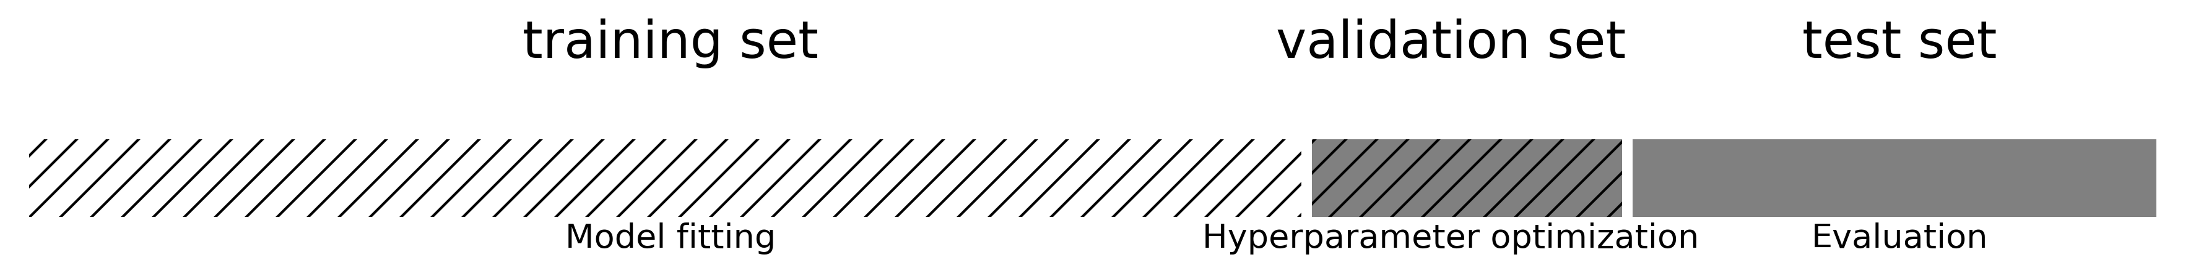
Model validation
Data needs to be split into training and test sets
Optimize model parameters on the training set, evaluate on independent test set
Avoid data leakage:
Never optimize hyperparameter settings on the test data
Never choose preprocessing techniques based on the test data
To optimize hyperparameters and preprocessing as well, set aside part of training set as a validation set
Keep test set hidden during all training

Slide 8
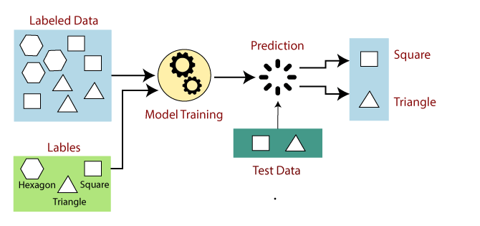
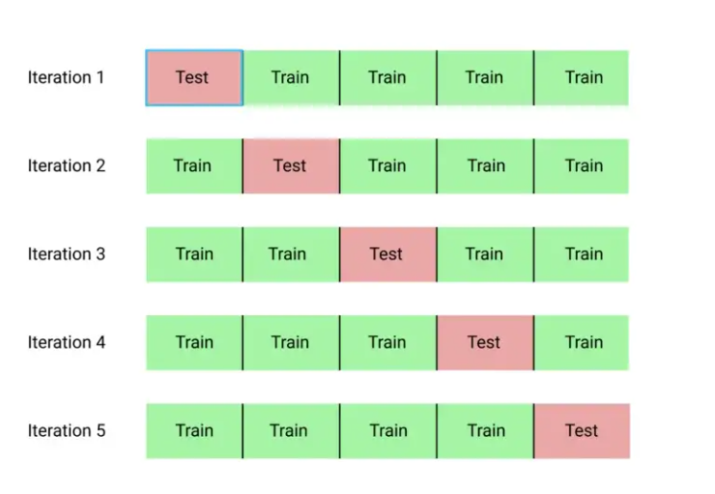
Training and Cross Validation
Cross Validation: A statistical technique called cross-validation is used to measure the efficiency (or accuracy) of machine learning models. It serves as a safeguard against overfitting in predictive models, especially when the available data may be scarce. In cross-validation, you divide the data into a predetermined number of folds (or partitions), analyze each fold individually, and then average the total error estimate.
K-fold Cross Validation
If the given shape has four sides, and all the sides are equal, then it will be labelled as a Square.
If the given shape has three sides, then it will be labelled as a triangle.
If the given shape has six equal sides, then it will be labelled as hexagon.
Randomly split your entire dataset into k number of folds (subsets)
For each fold in your dataset, build your model on k – 1 folds of the dataset. Then, test the model to check the effectiveness for kth fold
Repeat this until each of the k-folds has served as the test set
The average of your k recorded accuracy is called the cross-validation accuracy and will serve as your performance metric for the model.
For graph and logic: https://www.javatpoint.com/supervised-machine-learning

Slide 9



Confusion Matrix
Actual Values
Positive (1)
Negative (0)
The above equation can be explained by stating how many of the positive classes we correctly predicted.
Recall should be high as possible.
TP | FP
FN | TN
Positive (1)
Predicted Values
The above equation can be explained by asking how many of the classes we predicted to be positive are actually positive.
Precision should be high as possible.
Negative (0)
It is a performance metric for machine learning classification problems with two or more classes as output. It is a table with four different predicted and actual values.
It is difficult to compare two models that have low precision but high recall. So, we use F-Score to make them comparable. The F-score is useful for measuring both recall and precision at the same time. It employs Harmonic Mean instead of Arithmetic Mean, punishing extreme values more severely.

Slide 10
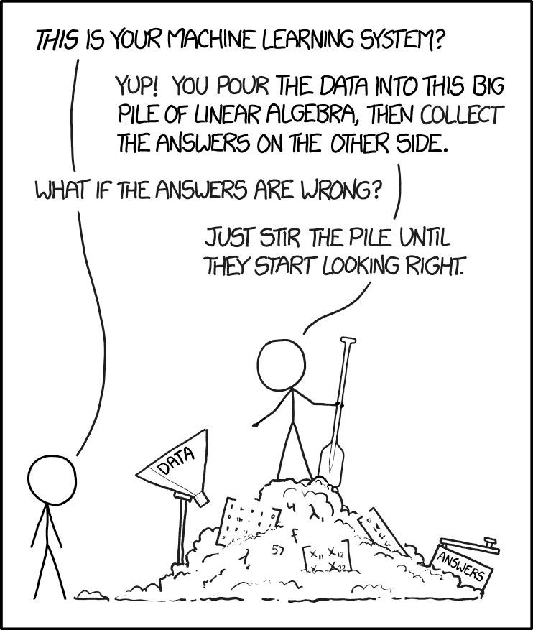
Model selection

Slide 11
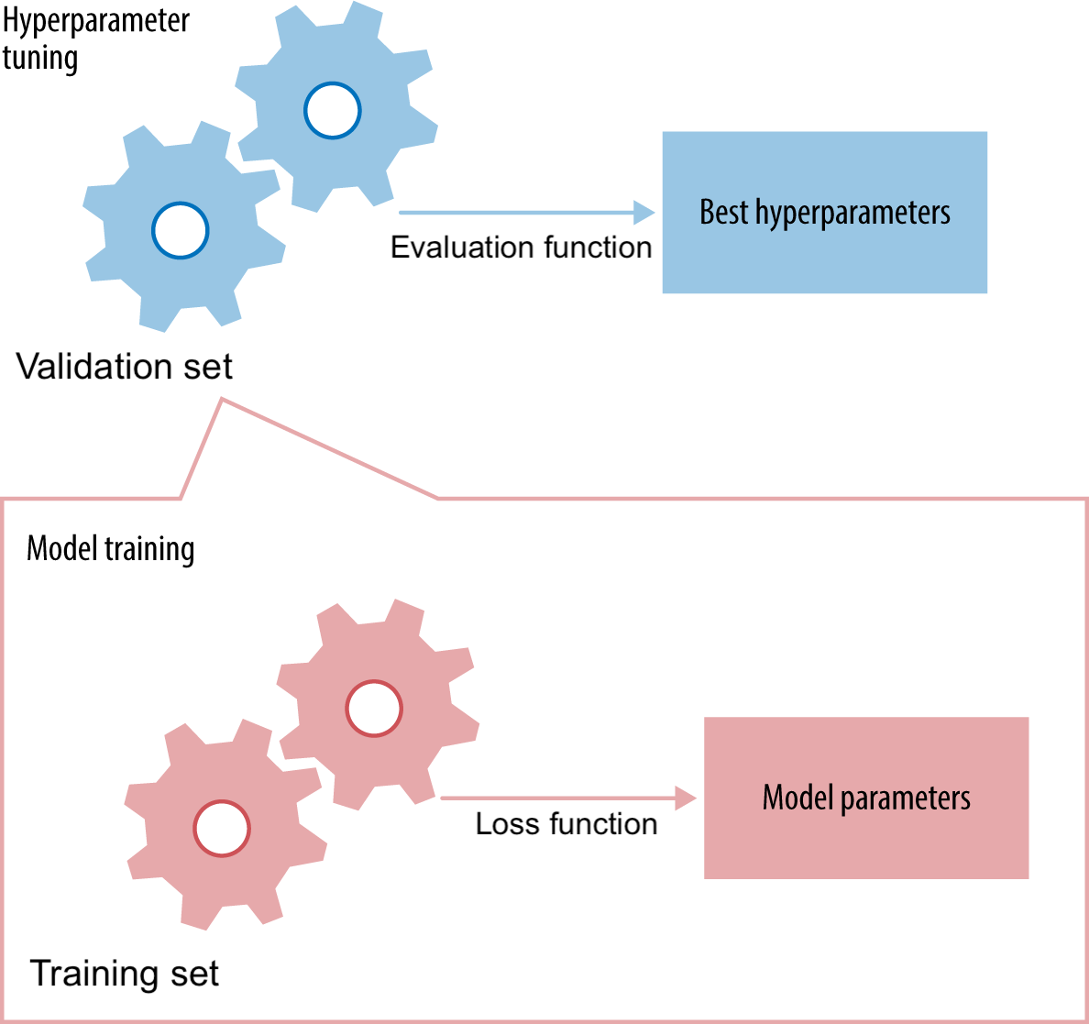
Model selection
For a given hyperparameter setting, learn the model parameters on training set
Minimalize the loss
Evaluate the trained model on the validation set
Tune the hyperparameters to maximize a certain metric (e.g. accuracy)

Slide 12
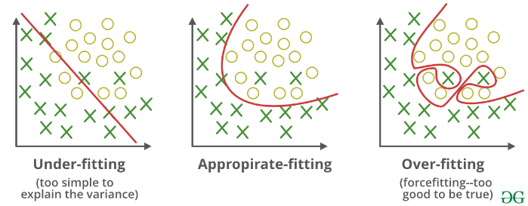
Overfitting and Underfitting
It's easy to build a complex model that is 100% accurate on the training data, but very bad on new data
Overfitting: building a model that is too complex for the amount of data you have
You model peculiarities in your training data (noise, biases,...)
Solve by making model simpler (regularization), or getting more data
Most algorithms have hyperparameters that allow regularization
Underfitting: building a model that is too simple given the complexity of the data
Use a more complex model
For the graph: https://www.geeksforgeeks.org/regularization-in-machine-learning/

Slide 13
Regularization
Regularization is a technique used to reduce the errors by fitting the function appropriately on the given training set and avoid overfitting.
The commonly used regularization techniques are :
L1 regularization
L2 regularization
Dropout regularization
A regression model which uses L1 Regularization technique is called LASSO(Least Absolute Shrinkage and Selection Operator) regression.
A regression model that uses L2 regularization technique is called Ridge regression.
Lasso Regression adds “absolute value of magnitude” of coefficient as penalty term to the loss function(L).

Slide 14
Learning and evaluation
Every algorithm has its own biases
No single algorithm is always best
Model selection compares and selects the best models
Different algorithms, different hyperparameter settings
Split data in training, and test sets
Prediction
Final optimized model can be used for prediction
Expected performance is performance measured on independent test set
Building machine learning systems

Slide 15
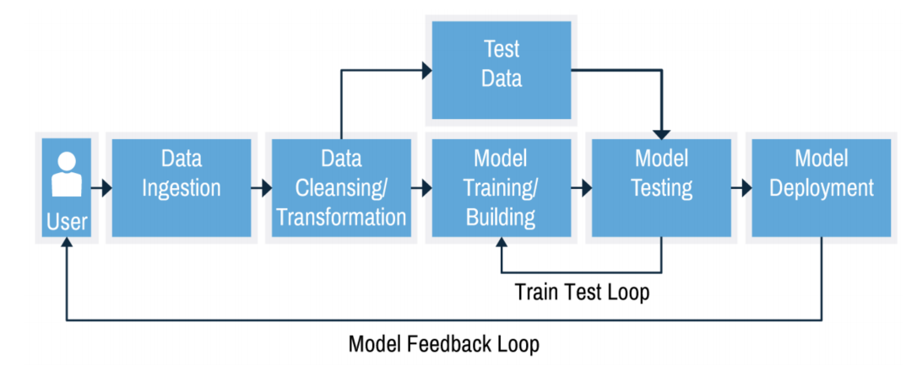
Building machine learning systems
Together they form a workflow of pipeline
There exist machine learning methods to automatically build and tune these pipelines
You need to optimize pipelines continuously
Concept drift: the phenomenon you are modelling can change over time
Feedback: your model's predictions may change future data

Slide 16
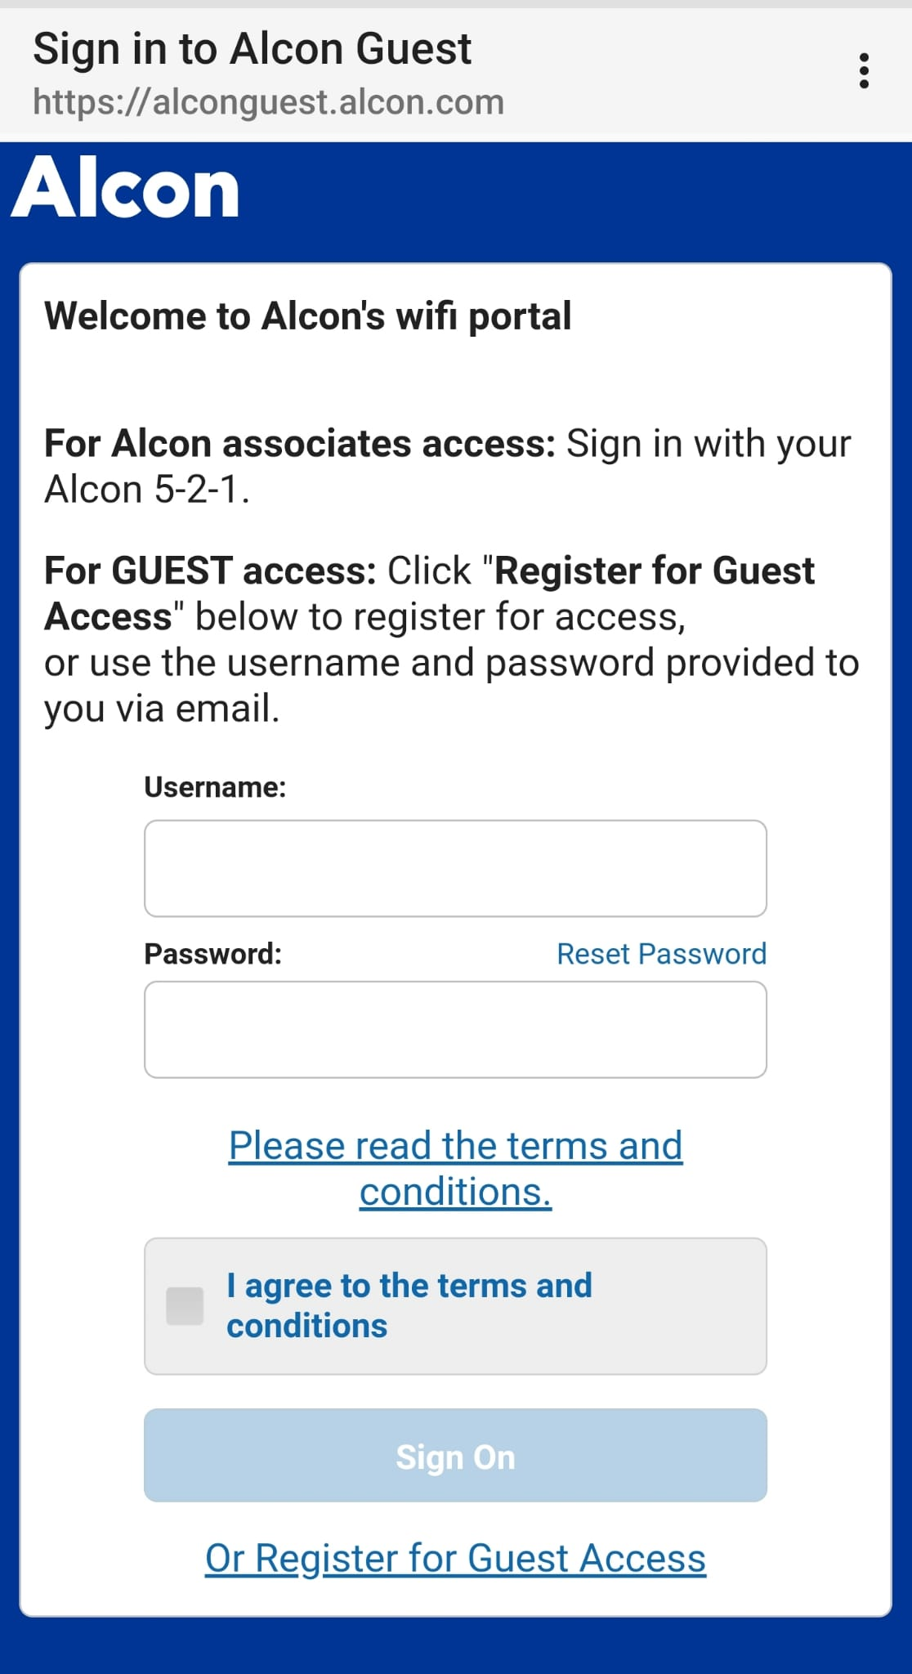
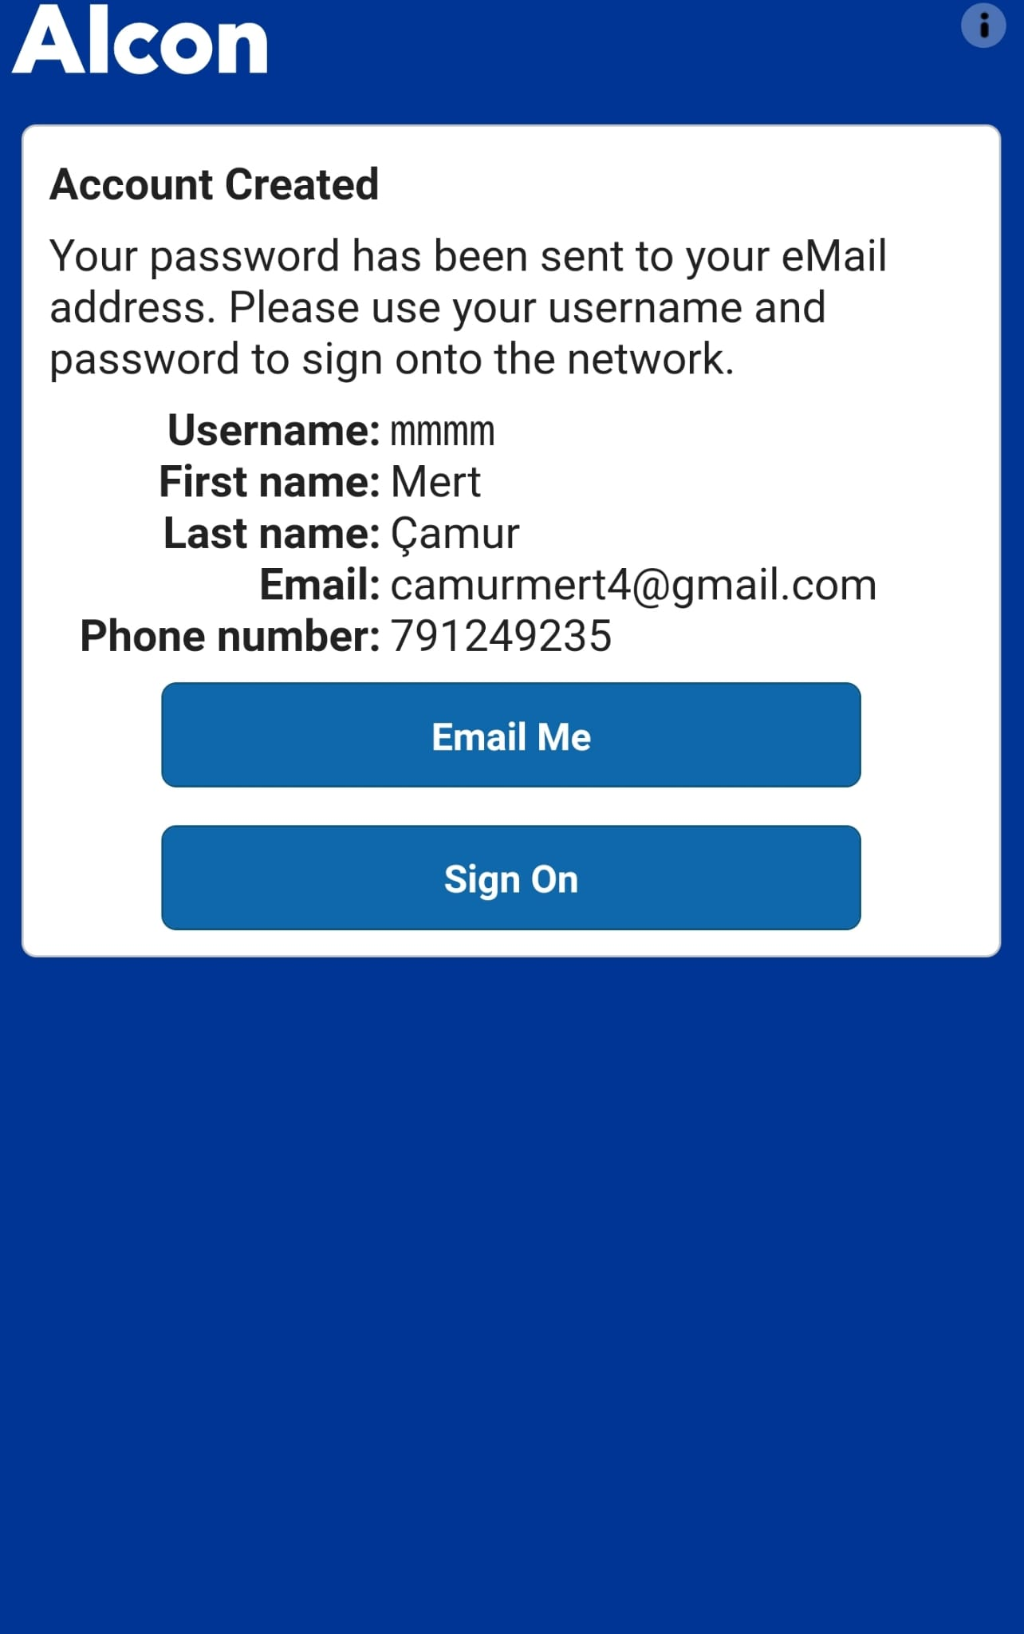
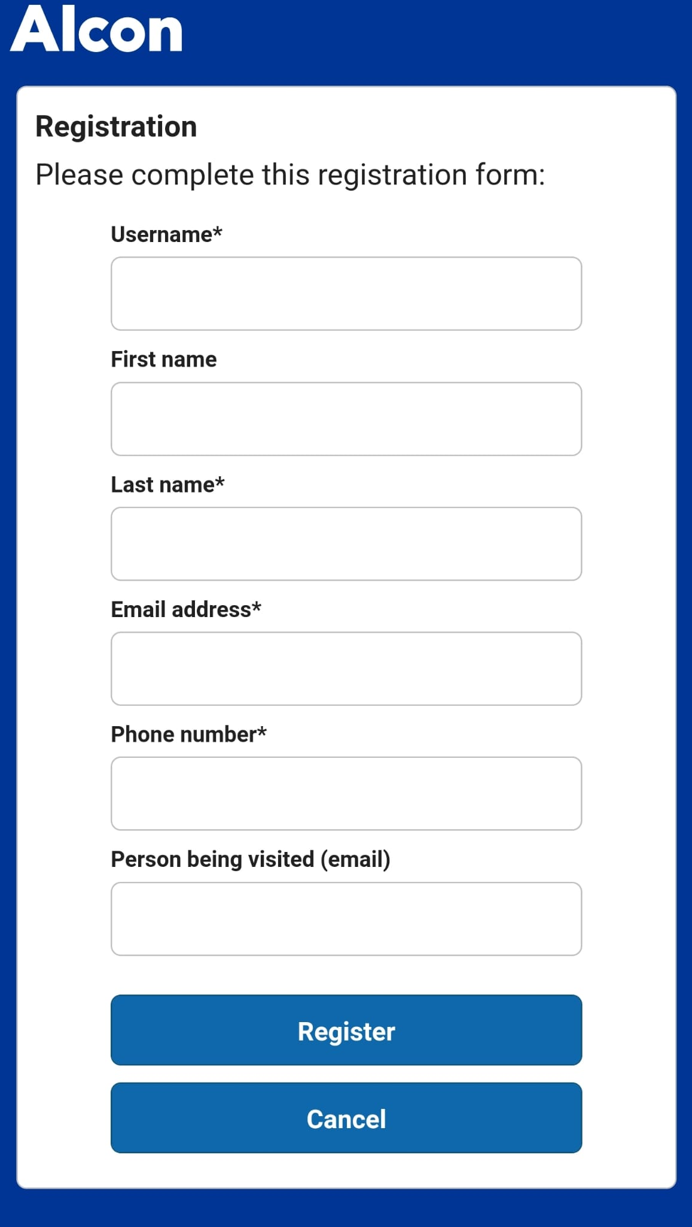
Example use in Python:
For Internet

Slide 17
Example use in Python:
For Exercise
https://github.com/Megrok/Clustering/tree/case_study_supervised

